Slide 1
SQL Fundamentals and
Concept of Database
Module - 3 Day - 04

Slide 2
Agenda
DATA vs Information
What is Database? And why it matters?
Table, Rows, and Columns
Types of SQL commands
Your First SQL Query: Select
How query Executes
Filters with WHERE, Sorting with ORDER BY
Grouping, Aggregations, and Handling Nulls
JOINS and its types
Combining with JOINS

Slide 3
DATA
Raw, unorganized facts, figures, observations, or symbols that have not yet been processed or contextualized.

Slide 4
Information
structured, processed, or organized data that has meaning and context .

Slide 5

What is Database?
Think of it as Digital filing cabinet.
A database is an organized collection of data stored electronically.
Why Database why not excel or any other tool?
Instead of keeping information in paper files or Excel sheets scattered across your computer, a database keeps everything in one place — organized, searchable, and secure.

Slide 6
Databases are everywhere:
Your bank stores your account balance and transactions.
Amazon stores products, prices, and your order history.
Your phone's contact list is a simple database.
Schools store student records, grades, and attendance

Slide 7

SQL (Structured Query Language)
Pronounced as Sequel or “S-Q-L”
Language we use to “communicate” to databases.
When you want to get data from a database, you write a SQL query (a question), and the database gives you an answer.
Simple Analogy / Example
Imagine a librarian (the database). You ask: "Show me all books by Nepali authors published after 2020." The librarian searches and gives you a list. SQL is how you ask that question to a computer!

Slide 8
Table, Column, and Row
Table: Customer_Details
ID | Name | Address | Zip Code
1 | ABC | Kathmandu | 4400
2 | XYZ | Lalitpur | 4444
3 | PQR | Bhaktapur | 4404
ROW
Column
Table
Collection of related data
Excel spreadsheet inside the database
Column
A specific attribute (name, address, zip code)
Row
One Completer record

Slide 9
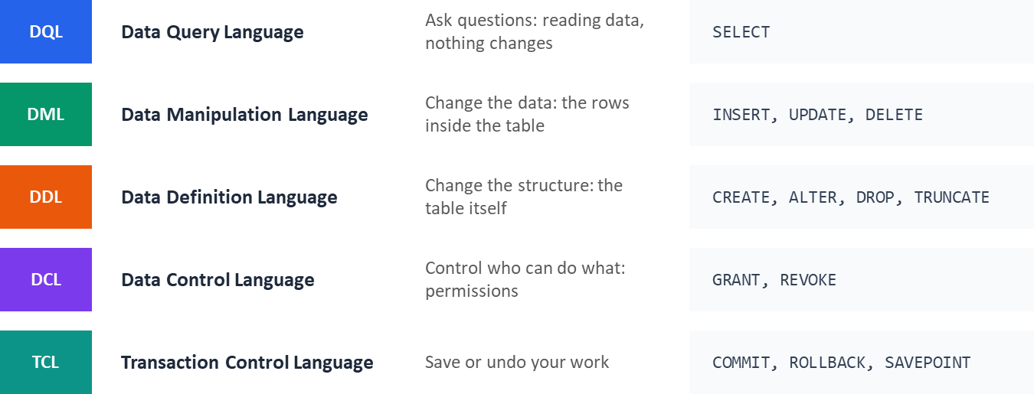
Types of SQL Commands:
SQL commands are grouped into 5 categories based on their function

Slide 10
There are lots of vendors for RDBMS like SSMS, Oracle, MYSQL, Postgres and many more.
But, We are using Postgresql for the course.
Because of its unmatched extensibility, permissive open-source license, and ability to handle multimodal data workloads (such as relational, document, and AI vector data) inside a single engine.

Slide 11
Your First SQL Query
Select tells what columns you want to see
Pro Tips:
Select * is used select all the columns
You can do simple maths in select statement like *, /, +, -
Select Column_Name1, Column_Name2
From Table_Name;
Example:
Get Name From Customer Table
Select Name
From Customer_Details;
Get Name and City From Customer Table
Select Name , City
From Customer_Details;

Slide 12
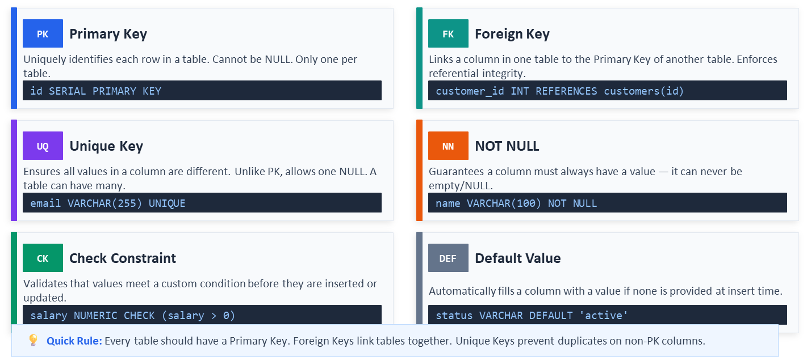
SQL Keys:
Keys enforce rules about uniqueness and relationships between tables

Slide 13

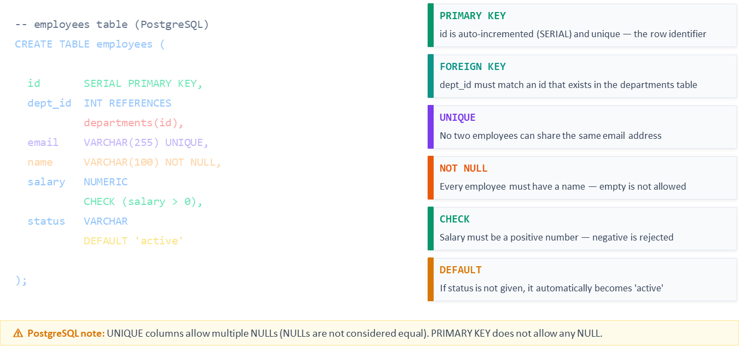
Keys In SQL:
How to declare every key type in a real CREATE TABLE statement

Slide 14
Constraints:
Used to prevent insertion of valid data, and ensures accuracy and reliability in the data.
PRIMARY KEY - Uniquely identifies each row in a table (a combination of a NOT NULL and UNIQUE)
FOREIGN KEY - Establishes a link between data in two tables, and prevents action that will destroy the link between them.
NOT NULL - Ensures that a column cannot have a NULL value.
UNIQUE - Ensures that all values in a column are unique.
CHECK - Ensures that the values in a column satisfies a specific condition.
DEFAULT - Sets a default value for a column if no value is specified.
CREATE INDEX - Creates indexes on columns to retrieve data from the database faster.
Syntax to add constraints:
Syntax to Remove:
ALTER TABLE products ADD CONSTRAINT chk_price CHECK (price > 0);
ALTER TABLE products Drop constraint chk_price ;
Create table Products(
ID int not null,
Name Varchar(50)),

Slide 15
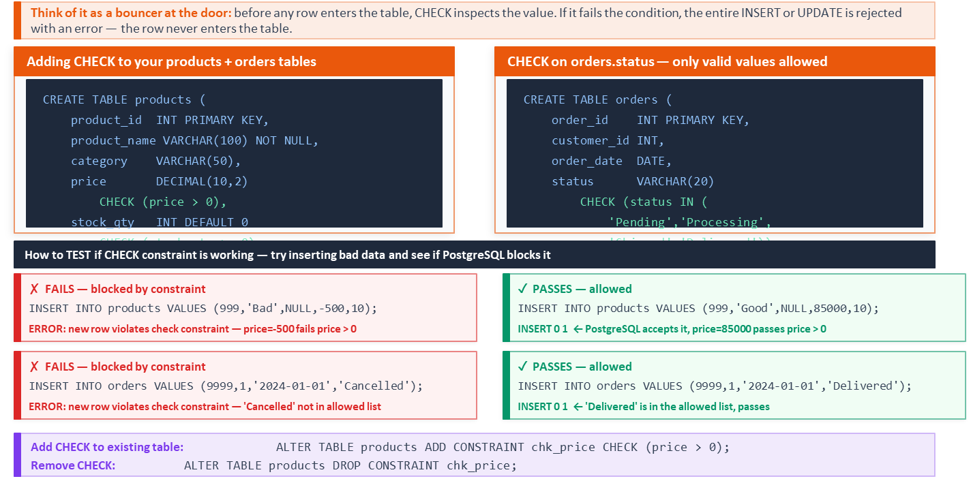
Check Constraints:

Slide 16
Tips:
Postgres rejects insertion, and updates on table/ rows incase it doesn’t the rules.

Slide 17
Any Questions?

Slide 18
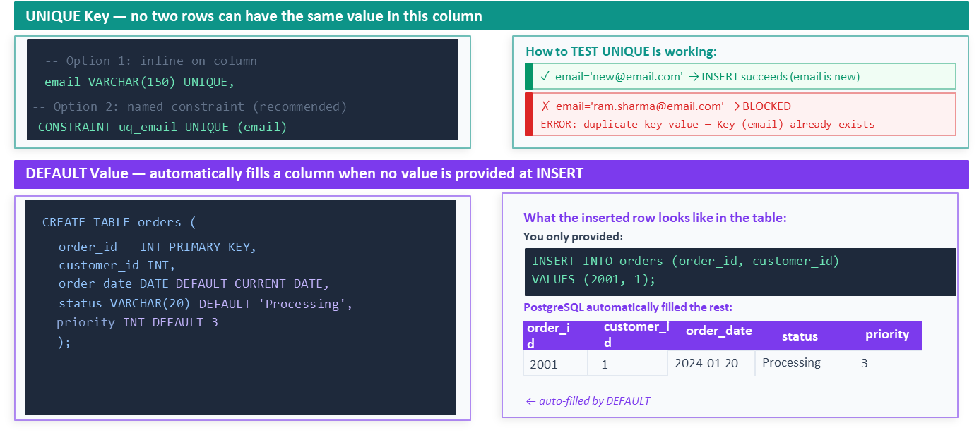
Unique Key and Default Value:
Two essential column-level rules — UNIQUE prevents duplicates, DEFAULT fills blanks automatically

Slide 19
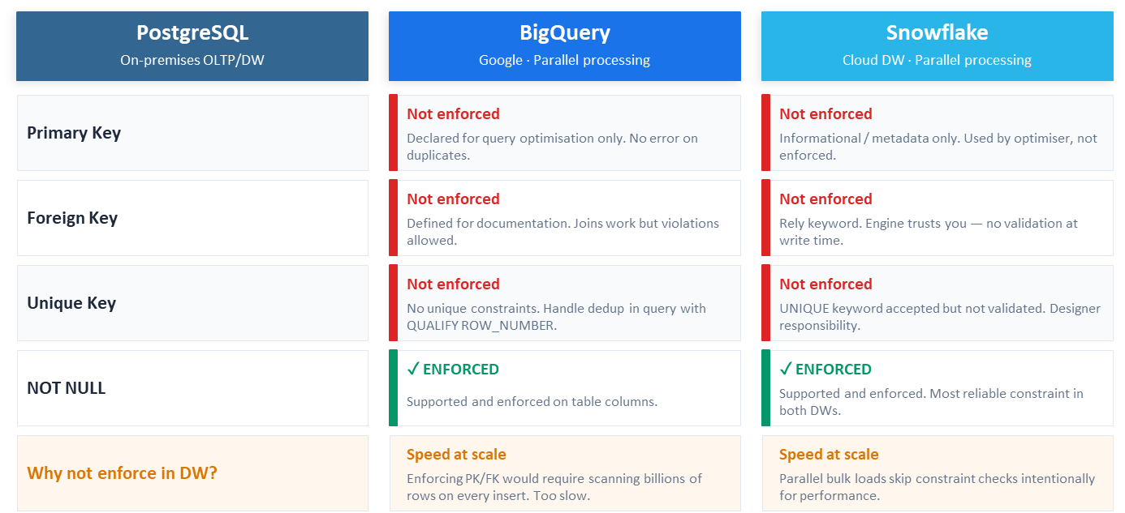
Keys: SQL vs Cloud Data Warehouse
PostgreSQL enforces keys strictly. BigQuery and Snowflake support keys differently — optimised for parallel bulk loading at massive scale.

Slide 20
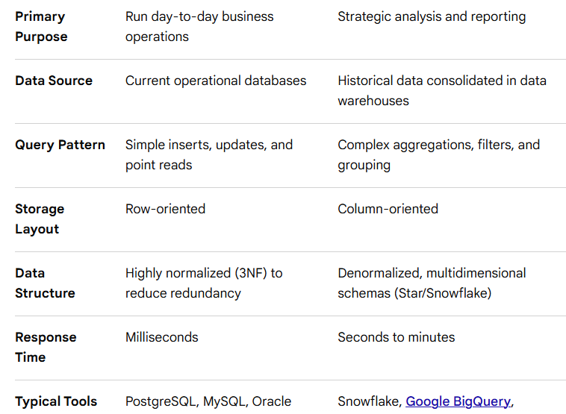
Appendix:
OLTP
OLAP

Slide 21
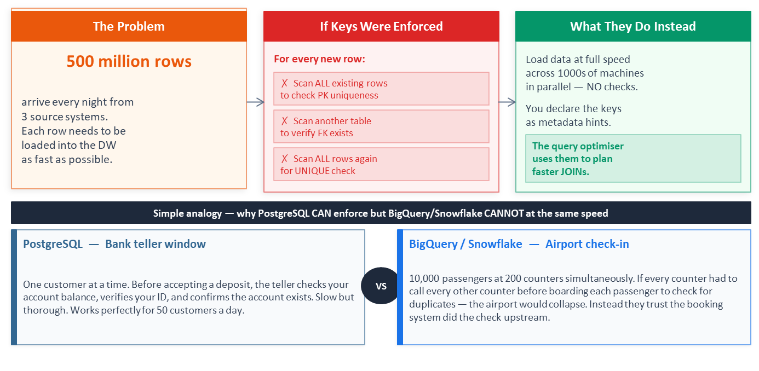
Why PK, FK, and Unique Keys Are Not Enforced in BigQuery & Snowflake
It is not a limitation — it is a deliberate design decision for speed at massive scale

Slide 22
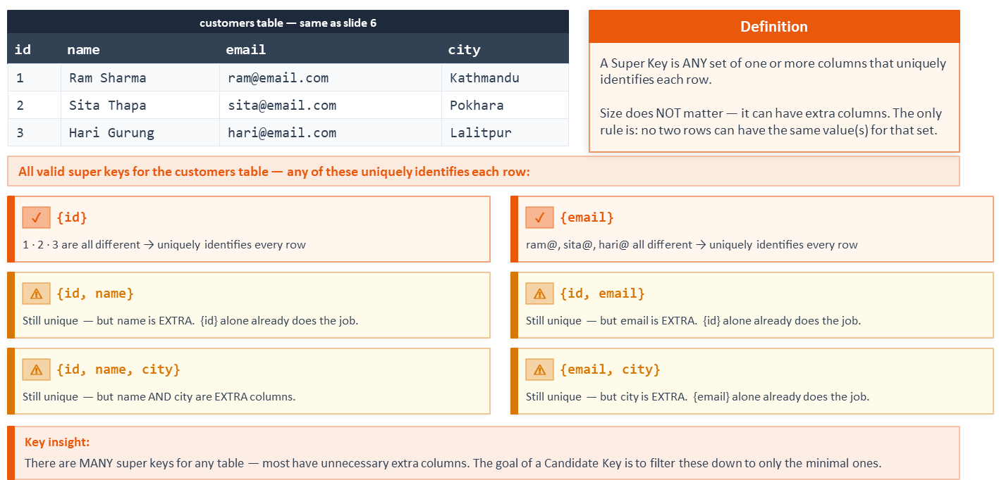
Super Key:
Any column or group of columns that can uniquely identify every row — including combinations with extra unnecessary columns

Slide 23
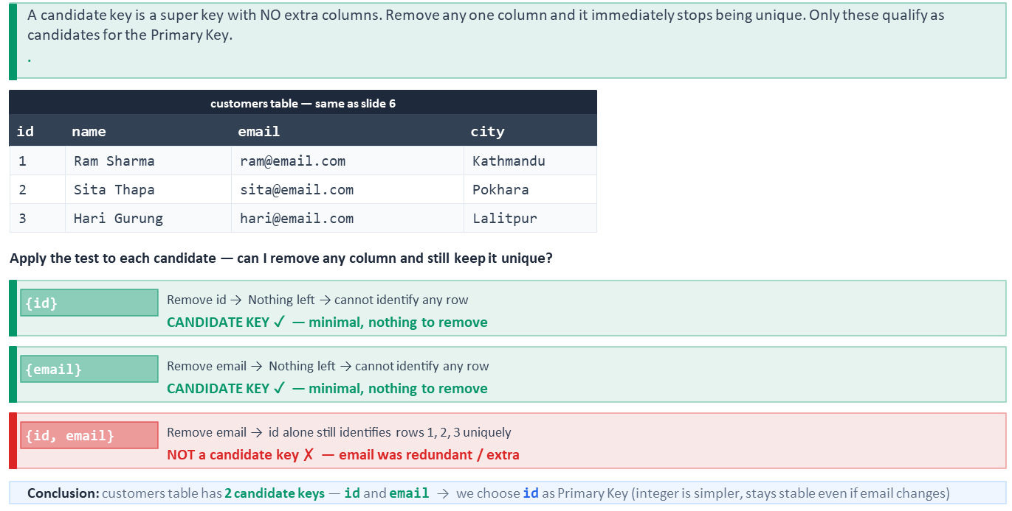
Candidate Key:
The minimal super keys — the only columns eligible to become Primary Key

Slide 24
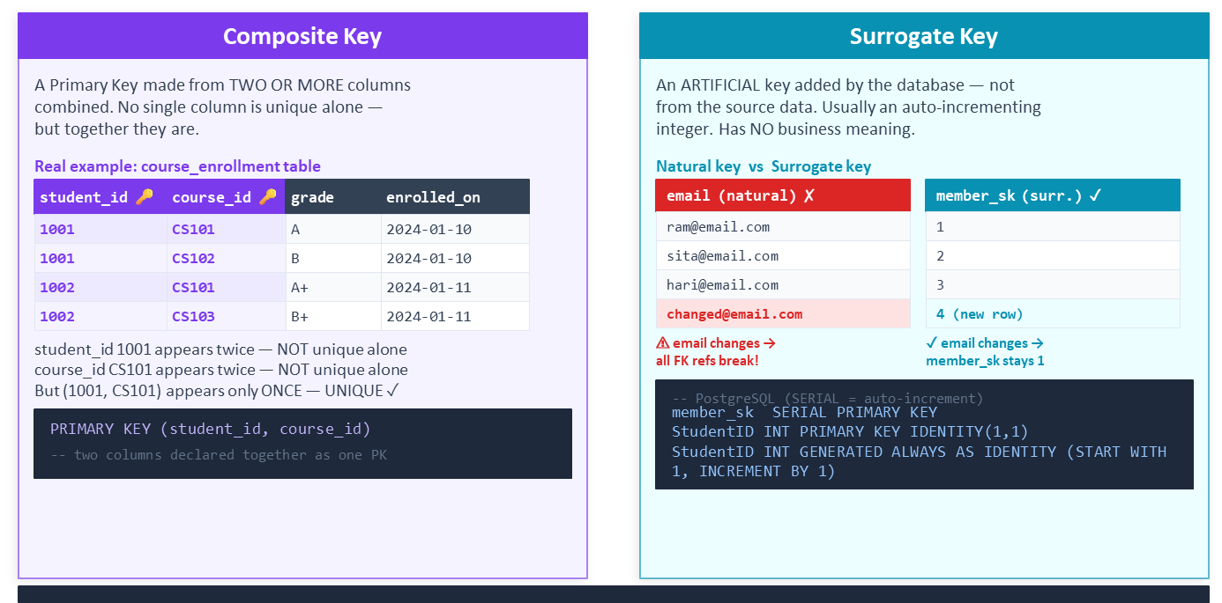
Composite Key vs Surrogate Key
Two key patterns you will use constantly in data warehousing and ELT pipelines

Slide 25
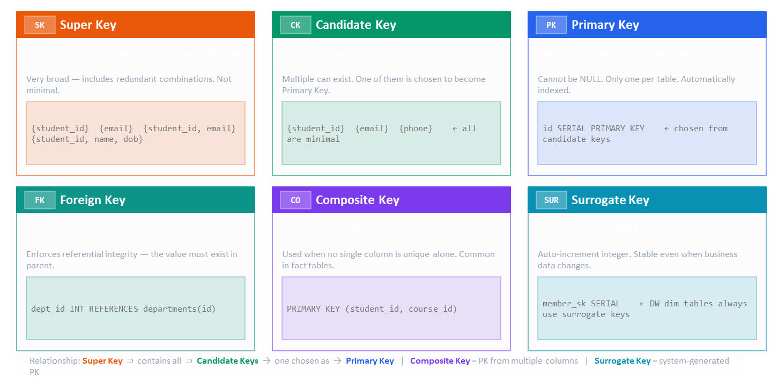
From the broadest concept (Super Key) down to the most practical implementation pattern (Surrogate Key)

Slide 26
Any Questions?

Slide 27
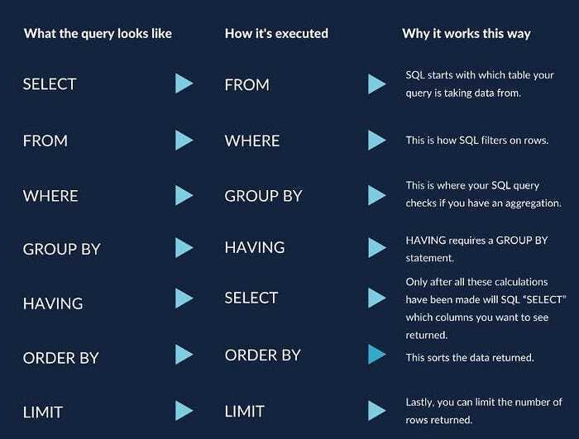
How does Query Works or From where query starts its Process?

Slide 28
Let's Do the SQL

Slide 29
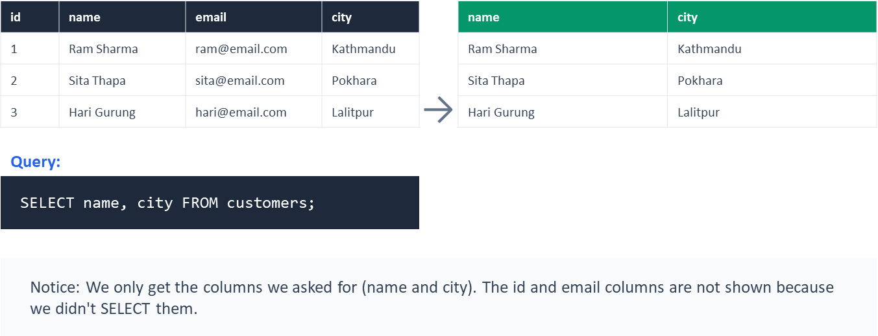
Select
Customers Table:
Result:

Slide 30

Filtering the Data with Where
WHERE lets you filter rows based on a condition
Example:
Find customers from Kathmandu.
SELECT *
FROM customers
WHERE city = 'Kathmandu';
Products costing more than 1000
SELECT *
FROM products
WHERE price > 1000;
Orders from a specific date
SELECT *
FROM orders
WHERE order_date = '2024-01-15';
Syntax:
SELECT column1, column2
FROM table_name
WHERE condition;

Slide 31
Operators
Arithmetic Operator ( +, -, *, /, %)
Comparison Operator ( =, != or <>, >, <, =<, >=)
Logical Operator ( AND, OR, IN, NOT, Between, LIKE, ISNULL, EXISTS)
Set Operator ( UNION, UNION ALL, INTERSET, and EXCEPT or MINUS)
Bitwise Operator ( &, |, and ^)

Slide 32
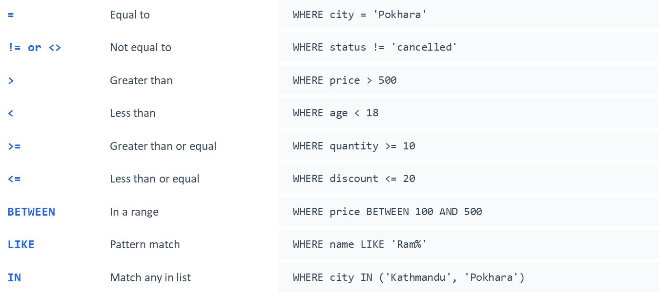
Basic Operators we use:

Slide 33
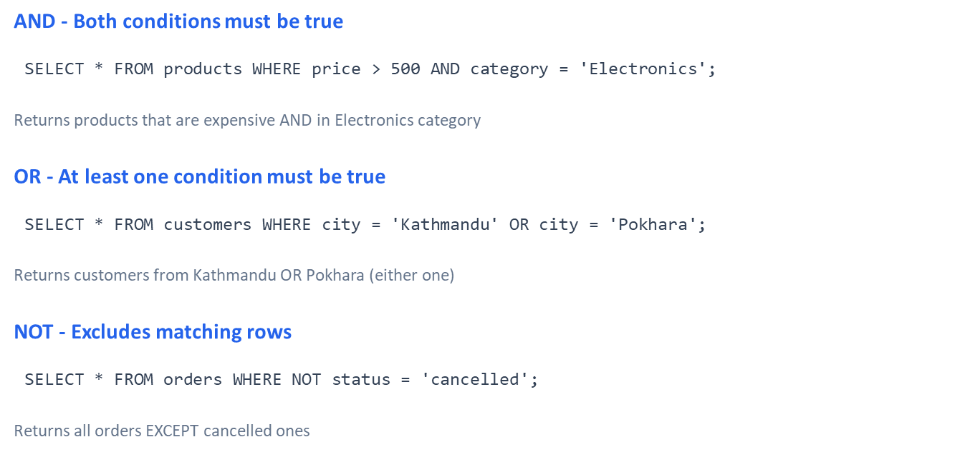
Combining Conditions: AND, OR, NOT

Slide 34
Any Questions?

Slide 35
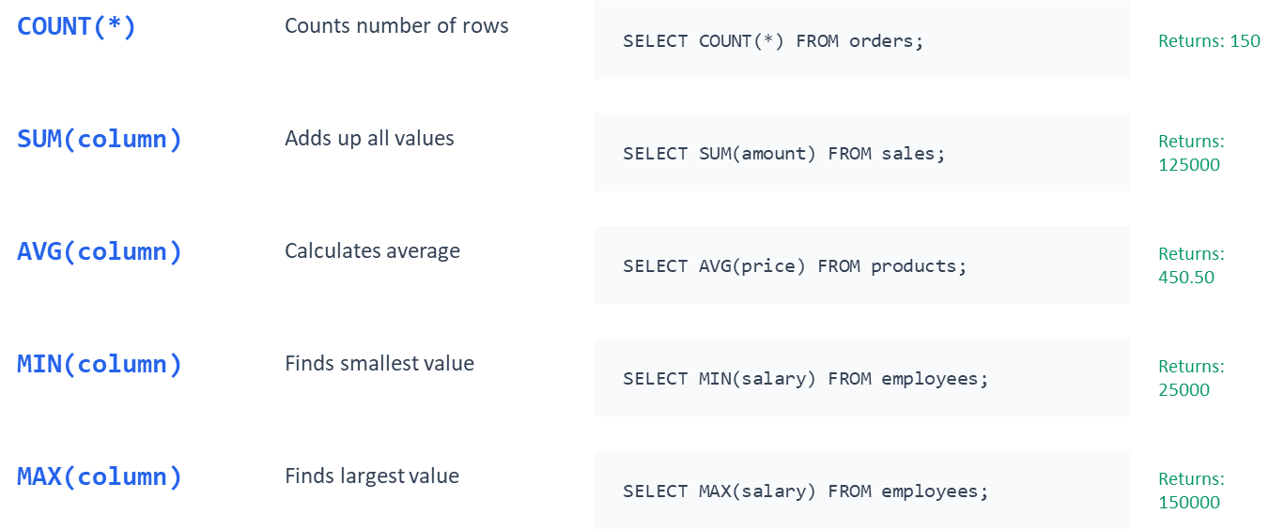
Aggregate Function:
Functions that calculate a single value from multiple rows

Slide 36
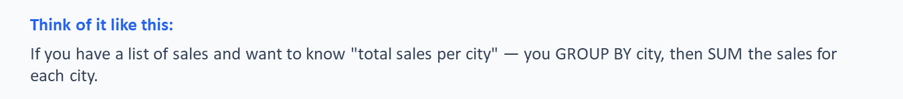
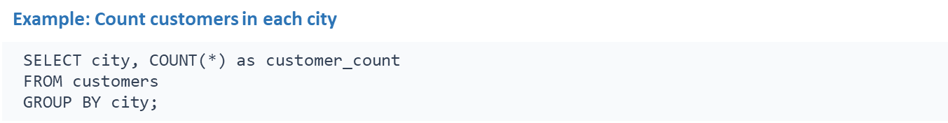

Grouping Data By Group By Function:
GROUP BY groups rows that have the same values and lets you perform calculations on each group
Syntax:

Slide 37
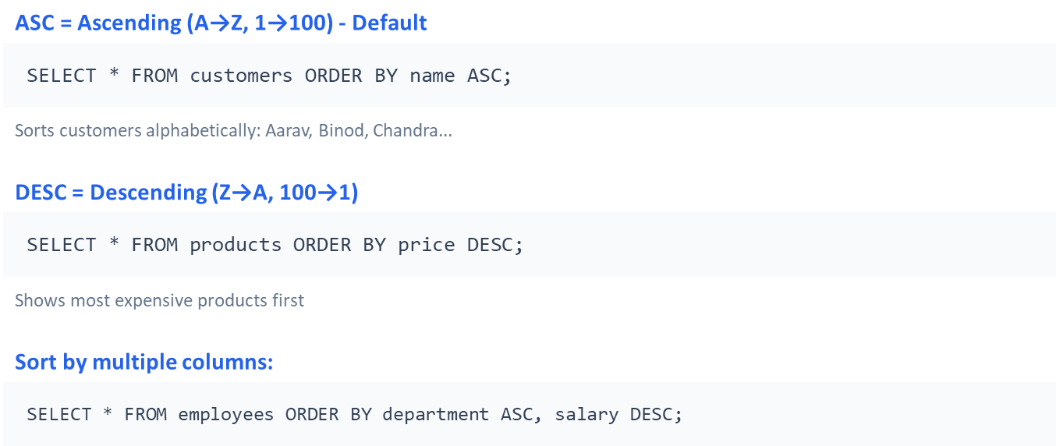
Sorting the Data OR Ordering using Order By:
ORDER BY arranges your results in a specific order

Slide 38
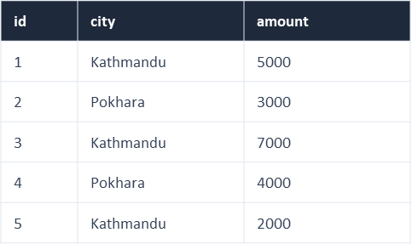
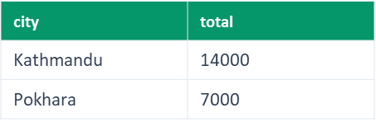
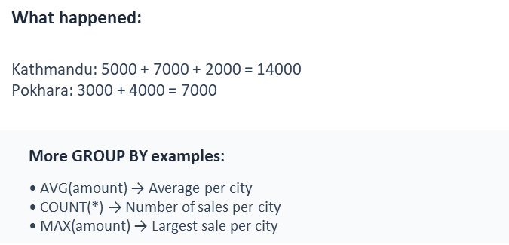
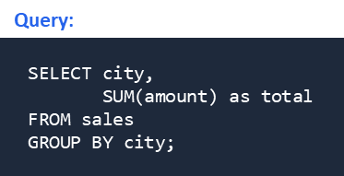
One more Example of Group By for better understanding:
Table Sales
Output:

Slide 39
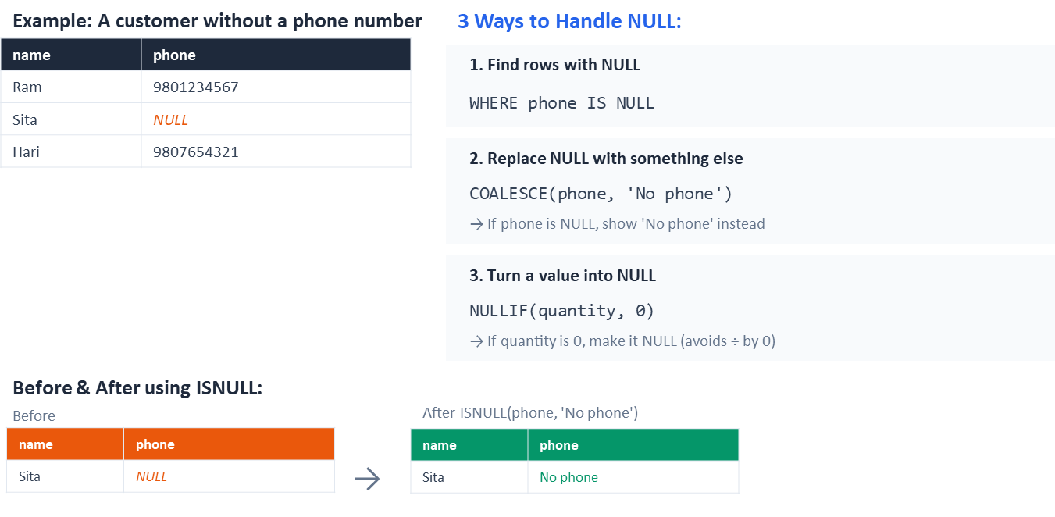
Handling Null Values
NULL means "empty" or "unknown" — it's not zero, not blank text

Slide 40
Any Questions?

Slide 41
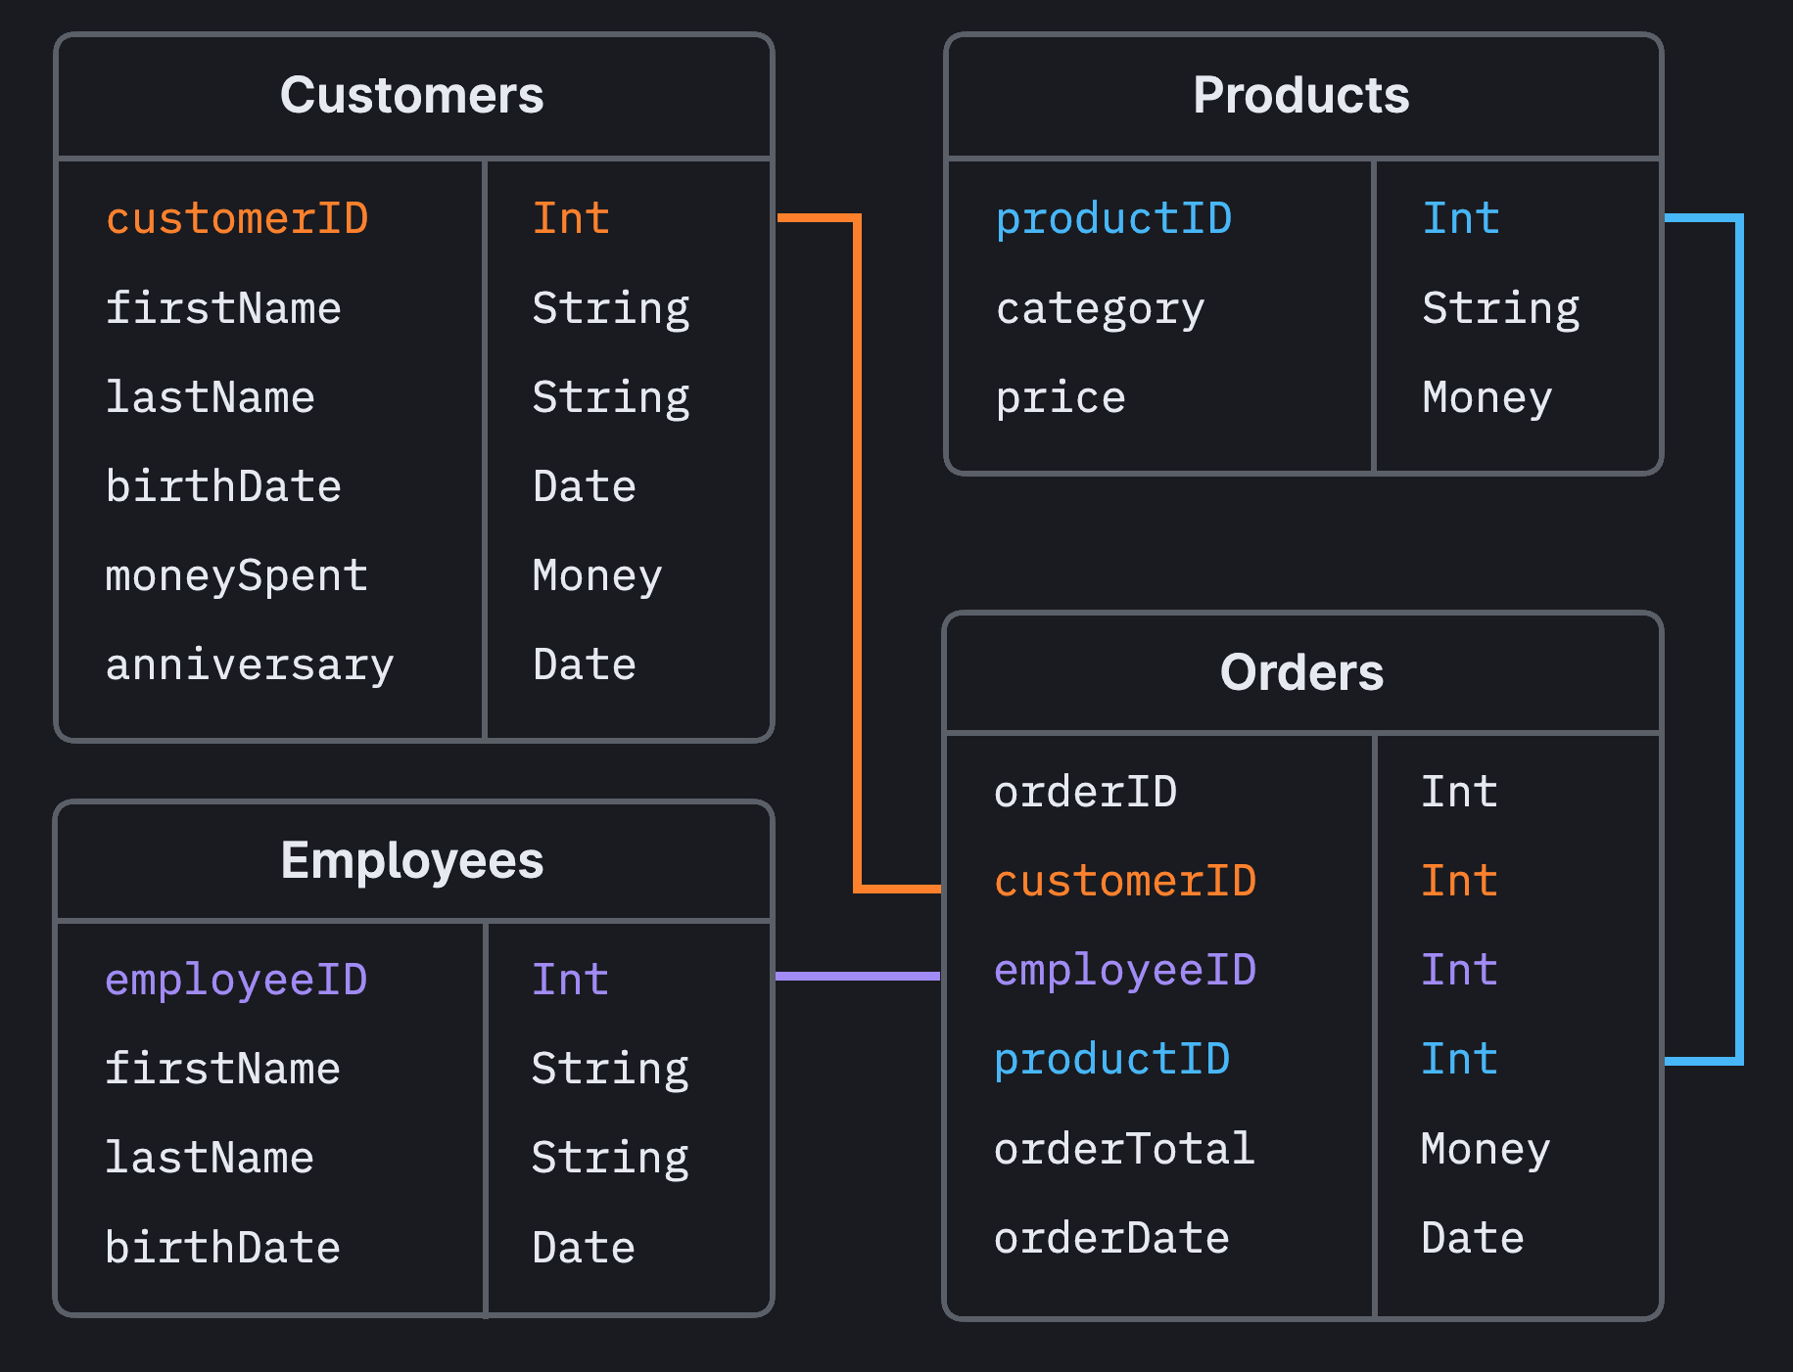
The Raw data are separated in multiple table in order to maintain structures and data make logical
There might be many tables, which must be join to extract the reports or valuable information. Here, the concept of Relationship is introduce between two entities can combined it with the help of attributes.
So,
Entity1:
Common Attribute
Entity2:
While joining the tables using attributes having keys, relation between two or more than two tables are formed and the whole process of joining and maintaining the relationship in database is called relational database i.e. RDBMS

Slide 42
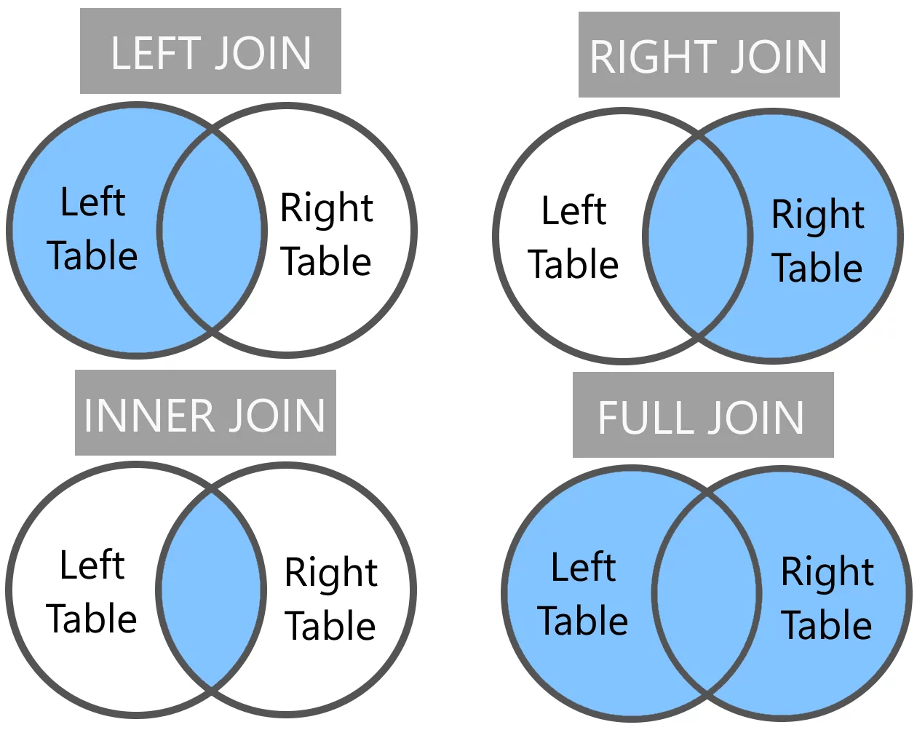
Joins

Slide 43
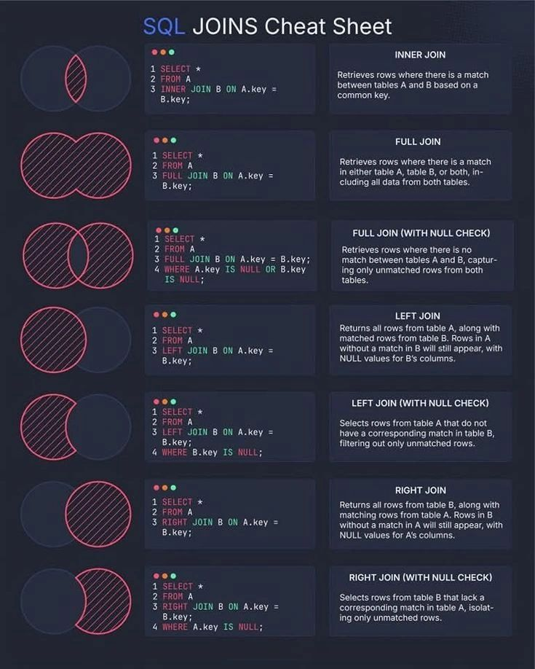
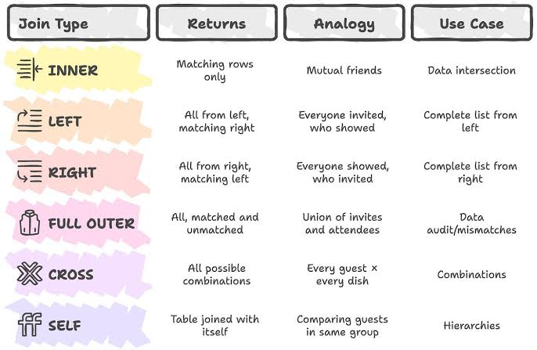
SQL Cheat Sheet

Slide 44
JOINS and Its Type:
used to combine rows from two or more tables horizontally based on a related column between them
Types of Joins:
Primary/ Basic Joins:
Left Join:
Right Join:
Inner Join:
Full Join:
Secondary Joins:
Cross Join
Self Join
Natural Join
Equi Join
Full Outer
Full Inner
Left Outer Join
Right Outer Join

Slide 45
Real database have multiple tables. JOIN lets you combine them.
Why multiple tables?
Imagine an e-commerce database:
Customer Table: Cust_id, Customer_Name. Email, and City.
Order Table: Order_id, Cust_id, Product, Quantity, Amount, Order_date.
Cust_id
Customer_Name
Email
City
Order_id
Cust_id
Product
Quantity
Amount
Order_date
The cust_id connects them, to see what customer ordered so we join them

Slide 46

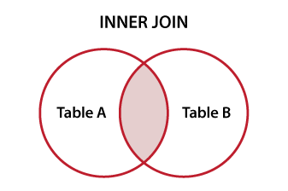
Inner Join
Returns only rows that have matching values in BOTH tables
Syntax:
Visual Diagram:
Example: Get customer names with their orders

Slide 47

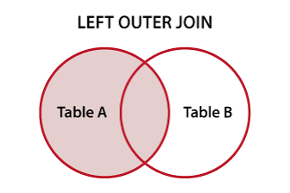
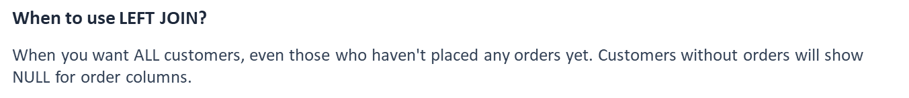
Left Join
Returns ALL rows from the left table + matching rows from right table
Syntax:
Visual Diagram:
Example:

Slide 48
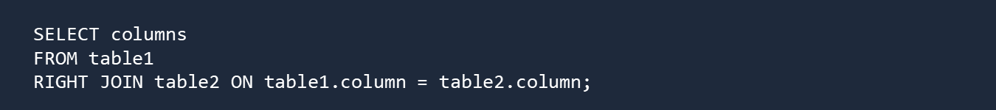
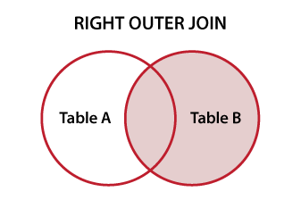
Right Join
Returns ALL rows from right table + matching from left
Syntax:
Visual Diagram:
Example:

Slide 49

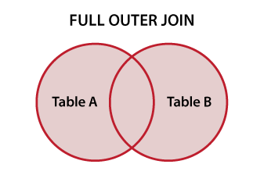
Full Join
Returns ALL rows from both tables (matching or not)
Syntax:
Visual Diagram:
Example:

Slide 50
Any Questions?

Slide 51
JOIN
Summary

Slide 52
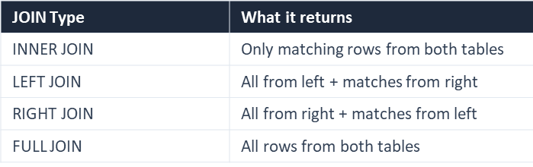

Slide 53
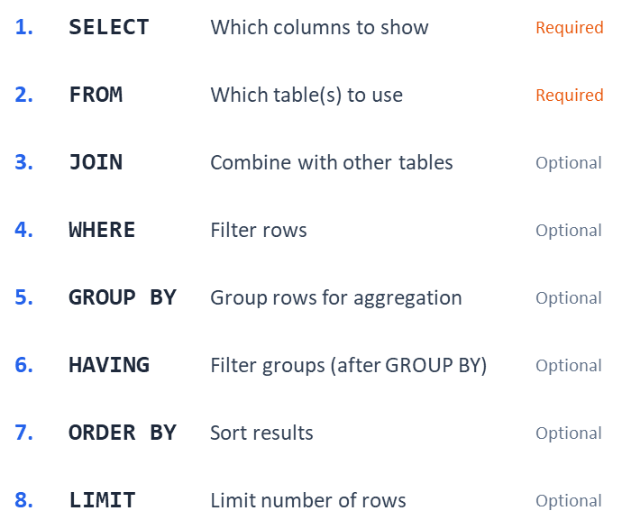
Query In
Order

Slide 54
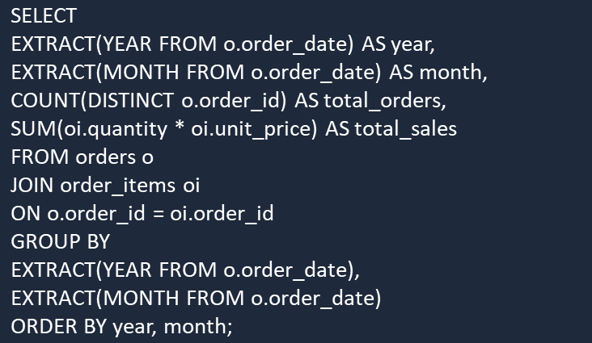
Putting Everything we have studied together:
Calculate the total number of orders and total sales for each month. The output should show the year, month, total orders, and total sales, sorted by year and month

Slide 55
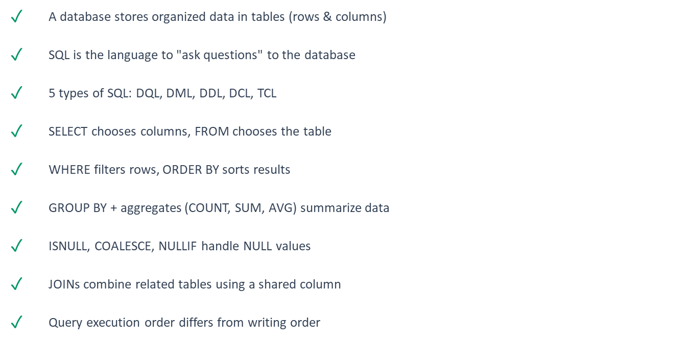
Key Takeaways:

Slide 56
Any Questions?

Slide 57
See You Tomorrow at Practical
Basic requirement for tomorrow’s Practical:
Laptop
SQL Knowledge
Postgres SQL Installation
Basic Knowledge of SQL
Study the Slide Well

Slide 58
Good Bye!
Have A Nice Day

